Slide 1
Movie Matchmaker Project Proposal CTEC-295 Software Development Jeffrey Walley | Spring 2025

Slide 2
Overview
Here’s the Pitch
Why this project?
Can this be completed in 8 weeks?
Tools and Experience for the build
Additional Tools needed for the build and issues that could be encountered

Slide 3

Movie Matchmaker
A Decision Assistant Application
This Photo by Unknown Author is licensed under CC BY-SA-NC

Slide 4
Here’s the Pitch!
Choosing a movie to stream with others can be a stressful and tedious waste of time.
Movie Matchmaker pulls current movie lists from all the major streaming services and allows you to create a list of your most liked movies and shows.
Movie Matchmaker compares your list with the list of friends and family to curate movies and tv shows that all will love.
If you’re planning a cozy night in, or a fun-filled evening with friends, Movie Matchmaker ensures everyone gets to watch what they love!

Slide 5
Why This Project?

Slide 6
Why Choose Movie Matchmaker
Solves a Common Problem: Addresses a widespread issue many people face, finding a movie or show that everyone in a group wants to watch. It's a practical solution that makes movie nights more enjoyable.
User Friendly: Movie Matchmaker’s easy-to-use interface and ability to link multiple streaming accounts ensure that everyone’s preferences are considered, promoting a positive experience.
Time and Stress Saver: By curating a list of common items, the app significantly reduces the time spent scrolling through endless options. This means less stress and more time spent enjoying movie night.
Innovative Use of Technology: The project leverages modern technology to enhance a social activity. We will incorporate algorithms to match users’ interests and provide a more efficient, and personalized, movie selection process.
Market Potential: There’s a growing demand for apps that simplify entertainment choices. With the rise of various streaming services, Movie Matchmaker has the potential to become a popular tool for households and friends worldwide.
Educational Value: Working on this project will provide valuable experience in app development, user interface design, and integration with streaming services. It’s an excellent opportunity for hands-on learning in a real-world context.
Engaging and Fun: Beyond its practicality, this project is for enjoyment! It encourages social interaction and shared experiences.

Slide 7
Dynamic delivery
Learn to infuse energy into your delivery to leave a lasting impression
One of the goals of effective communication is to motivate your audience
Metric | Measurement | Target | Actual
Audience attendance | # of attendees | 150 | 120
Engagement duration | Minutes | 60 | 75
Q&A interaction | # of questions | 10 | 15
Positive feedback | Percentage (%) | 90 | 95
Rate of information retention | Percentage (%) | 80 | 85

Slide 8
Project Achievables and Timeline
Week 1 | Week 2 | Week 3 | Week 4
Research apps | Create wireframes | Set up Server and Database | Create and manage user lists
Define project features | Get design feedback | Develop APIs | Develop algorithms for comparing lists
Create detailed plan | Finalize UI design | Integrate with streaming services | Test algorithms and current project quality
Setup version control | Ensure design is intuitive | Test and API calls | Adjust program code or API calls as needed
Collaboration opportunities | Balance of aesthetics and functionality |  | Ensure accurate and efficient recommendations

Slide 9
Project Achievables and Timeline
Week 5 | Week 6 | Week 7 | Week 8
Develop front end UI | Conduct testing of backend | Perform UAT (User Acceptance Testing) | Prepare deployment infrastructure and documentation.
Implement UI and data display | Conduct testing of frontend | Gather feedback | Deploy app to web host.
Ensure responsive and smooth UX | Perform app integration testing | Make adjustments | Monitor app for post-launch issues
Debugging UI/UX | Fix bugs and refine features | Conduct final test for stability | Address post-launch issues quickly
QA Testing of application

Slide 10
Experience and Tools for Build
I bring valuable experience that will contribute significantly to the success of the Movie Matchmaker project. I have hands-on experience working with API calls, which will be essential for integrating various streaming services and ensuring seamless data retrieval. Additionally, I have basic experience with database management, which will aid in effectively storing and handling user data and movie lists. My background in web design ensures that the app will not only be functional but also visually appealing and user-friendly.

Slide 11
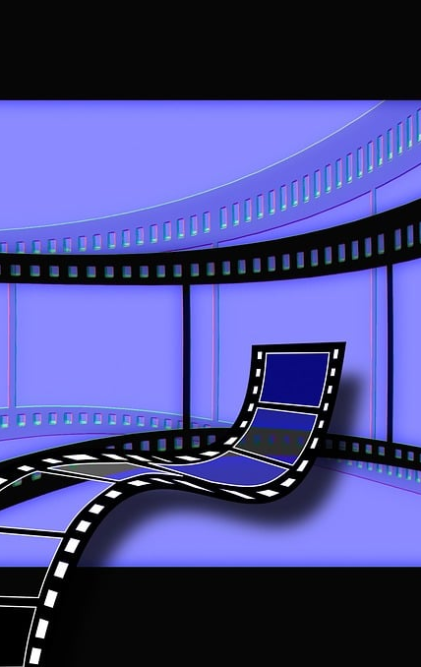
Additional Knowledge and Tools
For the Movie Matchmaker project, there are several areas of knowledge that would be beneficial to research more to successfully build the application. Advanced API integration is crucial for linking multiple streaming services, and tools like Postman will aid in testing.
Database management skills, including concepts like normalization and efficient query optimization, will be essential, with tools such as MongoDB being highly relevant. Backend development with frameworks like Node.js, Django, or Flask will also important. Improving frontend development capabilities with modern frameworks like React, will ensure a responsive and user-friendly interface. Focusing on responsive design and user experience (UX) will be beneficial, utilizing tools like Figma, Adobe XD, and CSS frameworks like Bootstrap or Tailwind CSS.
Effective project management and collaboration are crucial, with GitHub for version control, a project management app could be beneficial, and Discord or Slack for communication. Finally, understanding testing methodologies and tools for frontend and backend testing will be essential to ensure application quality assurance.

Slide 12
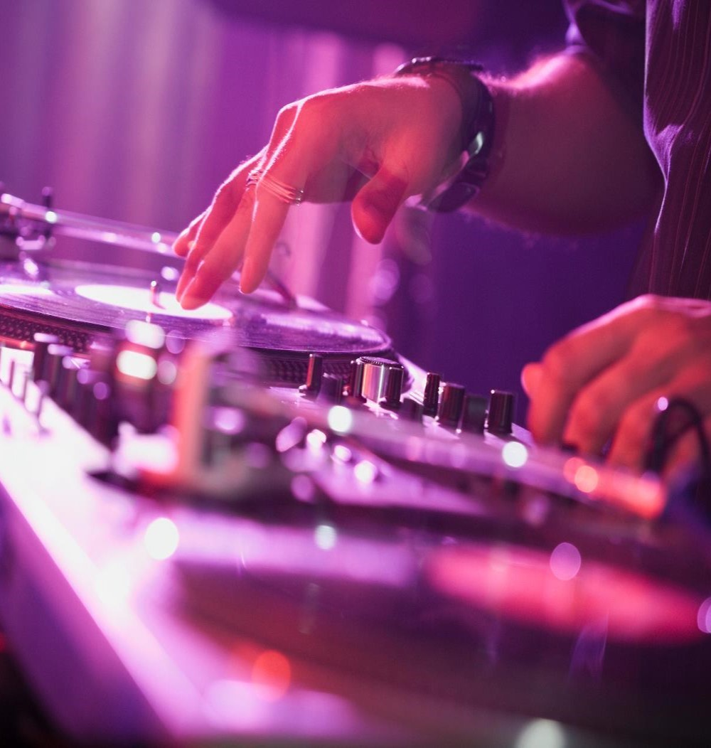
Conclusion
In conclusion, I believe we can successfully complete Phase 1 of the Movie Matchmaker project within 8 weeks. Positive initial results will pave the way for Phase 2, enhancing the application's features and reach. Let's work together to make movie nights fun again!

